Slide 1

C++ PROGRAMMING
DAY 3
By SHIVAM GUPTA

Slide 2

About Me
I am Frontend Web Developer and open source enthusiast.
Mentor at STUDENT CODE-IN.
Connect with me here:
LinkedIn: https://www.linkedin.com/in/shivamgupta57121/
GitHub: https://github.com/shivamgupta57121
Twitter: https://twitter.com/ShivamG57121

Slide 3
CONTROL STATEMENTS
They helps us to change the order of execution.
If-else
Loops - for,while,do-while
Goto
switch

Slide 4
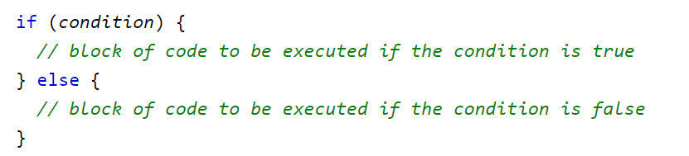
If else statements
If can also be executed without else part.
We can have nested if-else statements too.
If else ladder

Slide 5

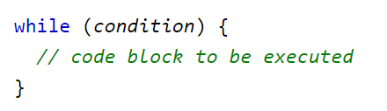
WHILE LOOP
Entry control loop

Slide 6
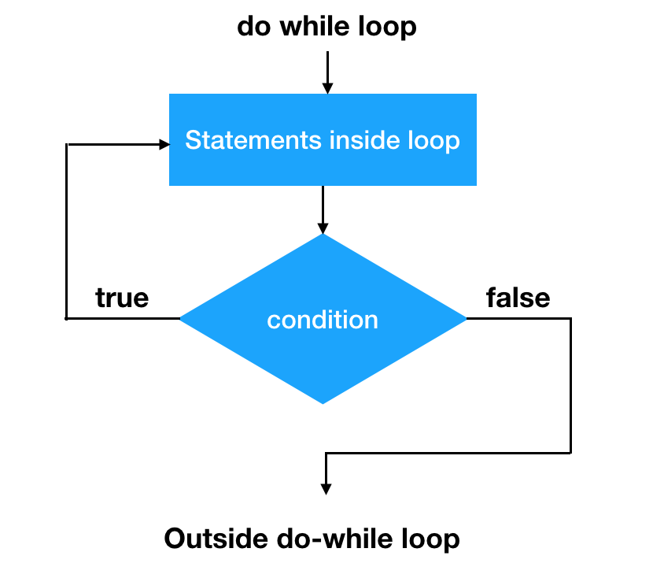
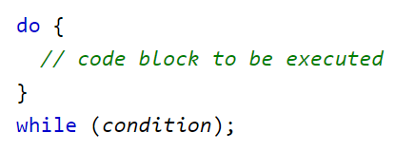
DO WHILE LOOP
Exit control loop
The body of the loop will be executed atleast once.

Slide 7
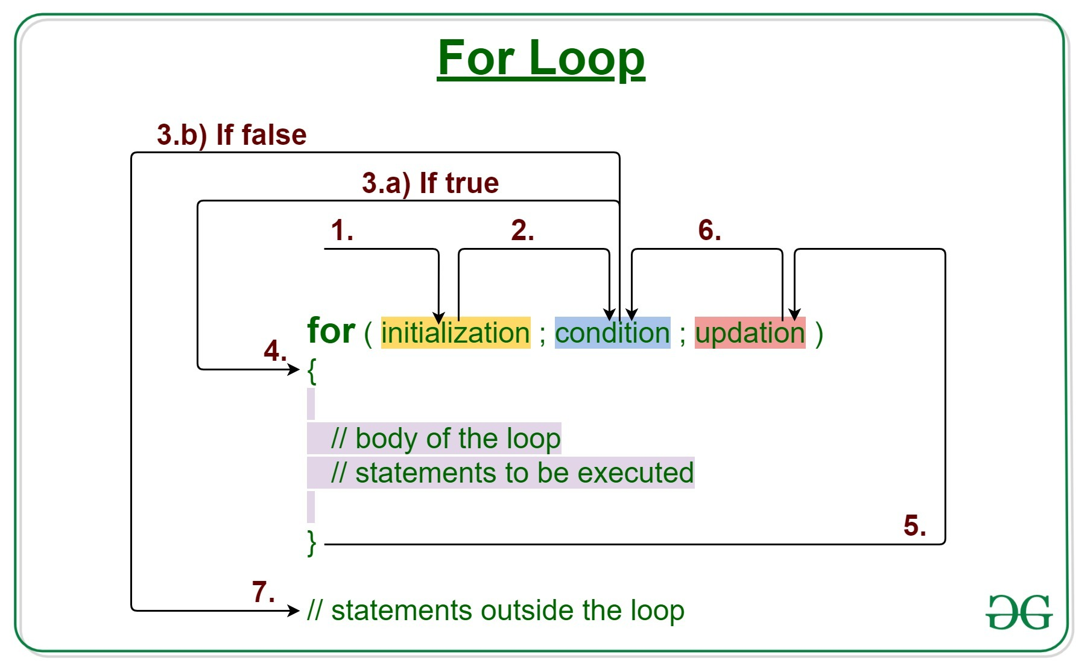
FOR LOOP

Slide 8
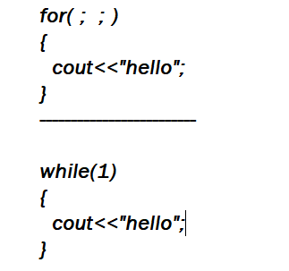
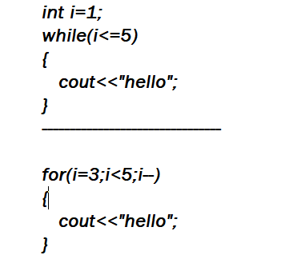
INFINITE LOOPS
Lets see some common mistakes that leads to infinite loops.

Slide 9
BREAK AND CONTINUE
Break is used to stop the loop.
Continue is used to skip the statements present in the loop.

Slide 10
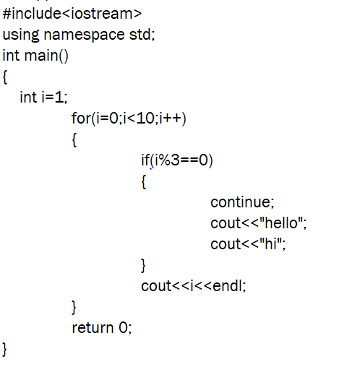
Predict the output.

Slide 11
GOTO
Unconditional transfer of control
Uses labels , which are also identifiers
Forward jump , backward jump

Slide 12
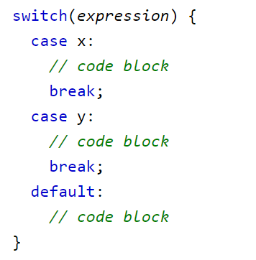
SWITCH CASE
Useful when we need to choose among various options.

Slide 13
Practice Problems
Find grade of student given marks in 4 subjects.
Find larger of two numbers.
Find given number is negative or positive.
Find if a year is leap year or not.
Print all the numbers from 1 to n using while, do-while and for loop.
Print sum of digits of given number.
Print Fibonacci Series.
Find out number is prime or not.
Find out if a number is odd or not using goto statements.
Basic Calculator using switch case.
Find a raised to power b without using power function.

